Slide 1
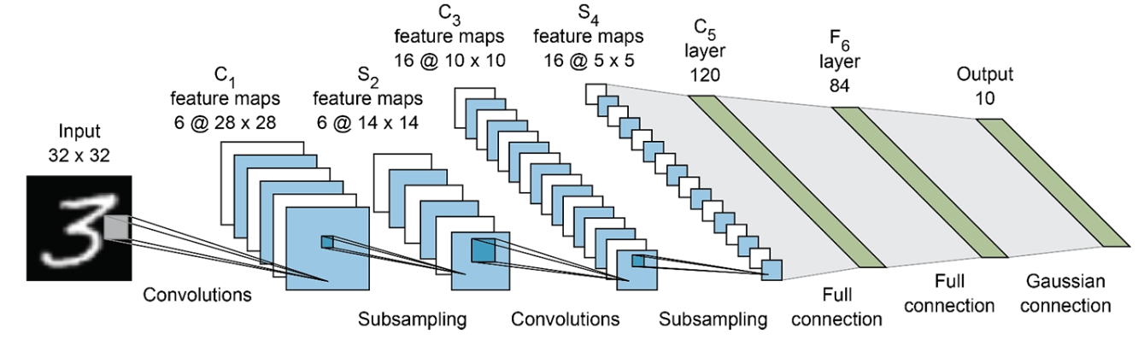
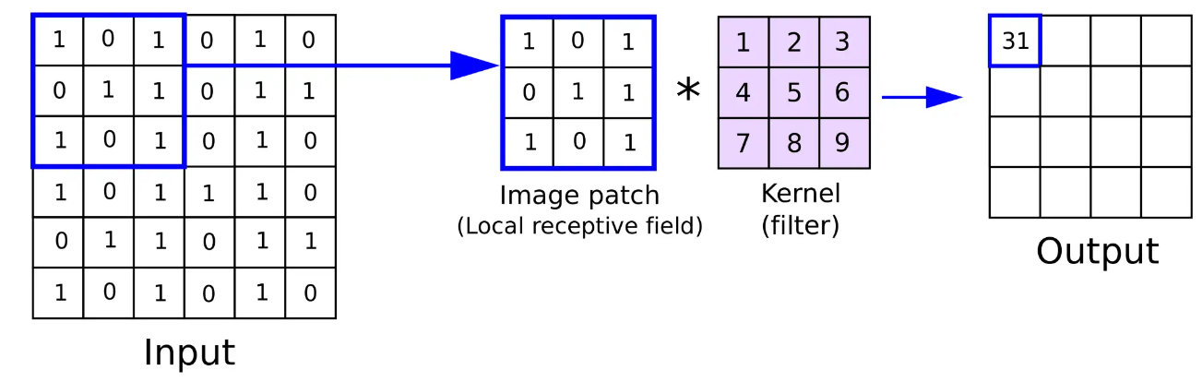
Medical image classification with Convolutional Neural Networks (CNNs)

Slide 2
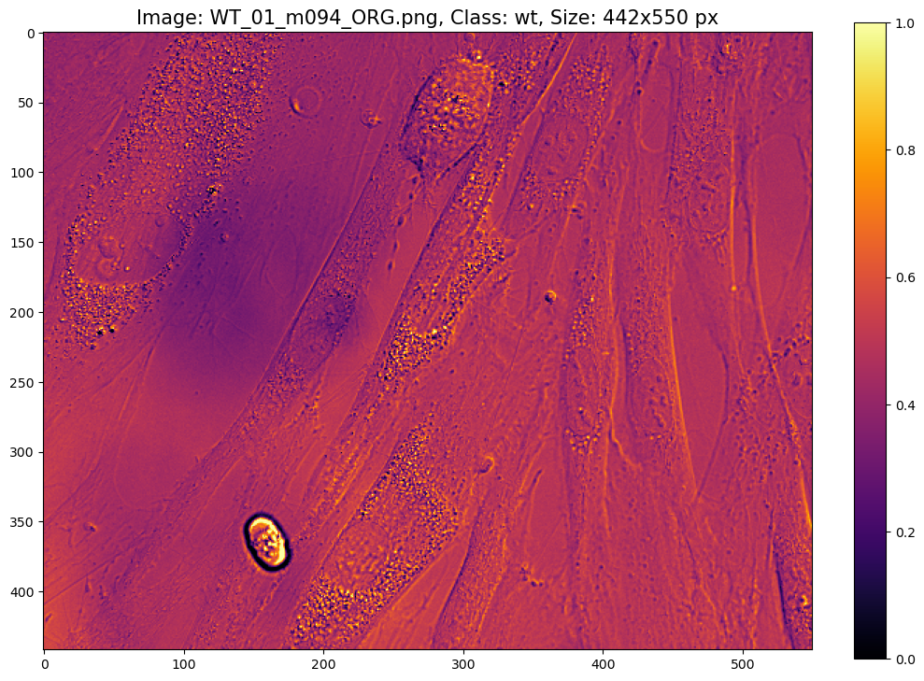
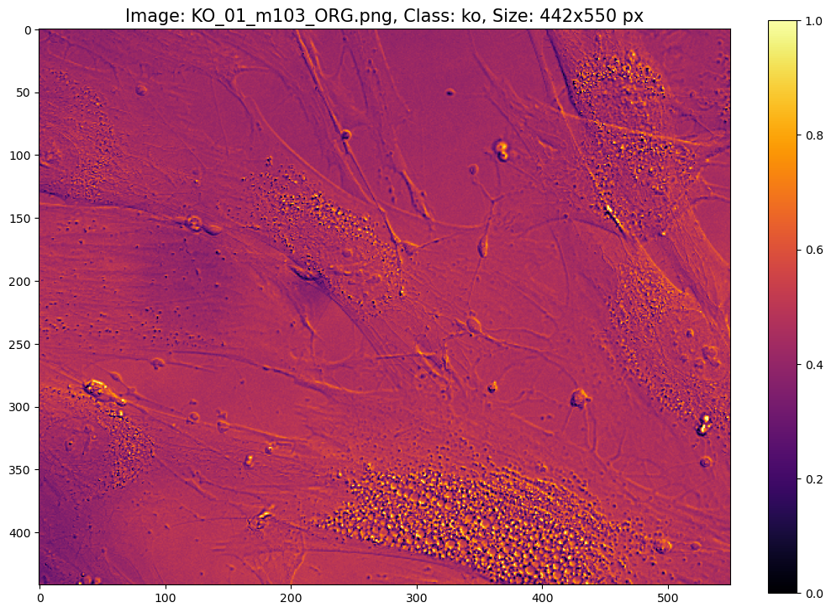
Aim of the study
Discrimination of fibroblasts from CLN7 patients (ko) and healthy people (wt)
Images look very similar. No way a human can do this!
Maybe a neural network can!
Convolutional Neural Network (CNN) specialized on image classification and image recognition
Example wt:
Example ko:

Slide 3
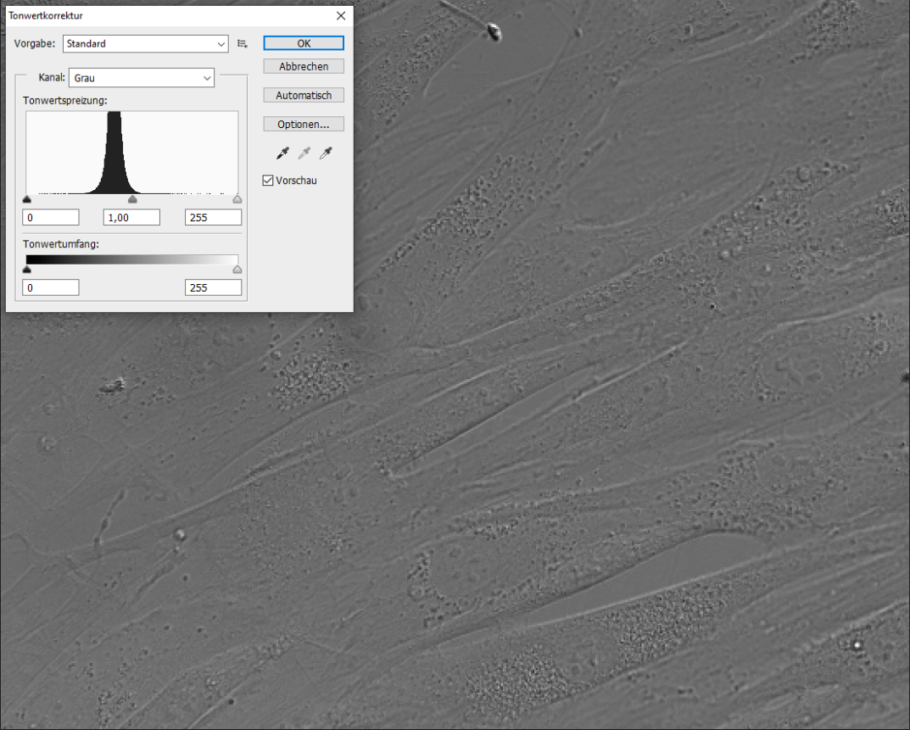
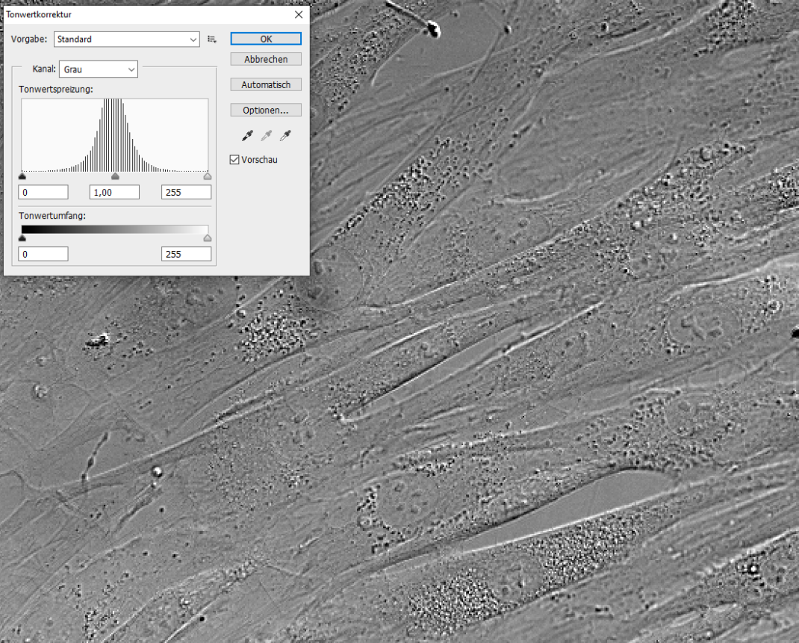
Image preparation
Cultivated on coated coverslips until a density of 90-100% was reached (not at the same time point!)
Images were performed on a Zeiss Microscope using a 60x (oil) objective and DIC contrast
Images were converted to 8-bit grayscale and downscaled to 20% (550x442 px)
An exposure time was chosen so that the histogram was centered
Photoshop auto contrast applied to all images as batch process
Before auto contrast:
After auto contrast:

Slide 4
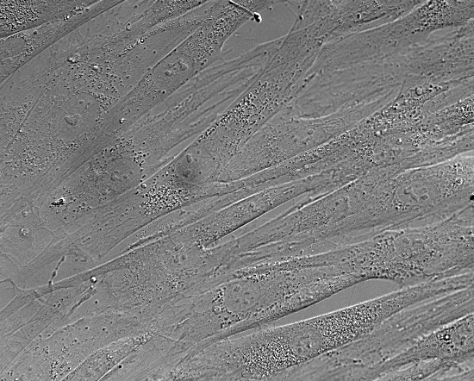
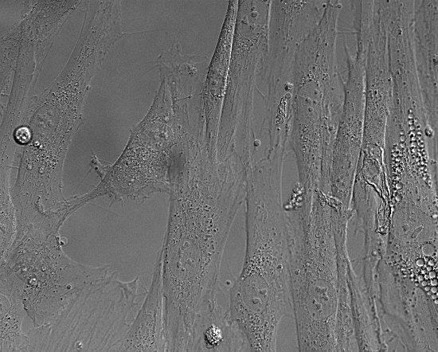
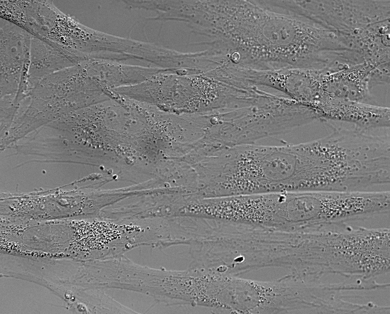
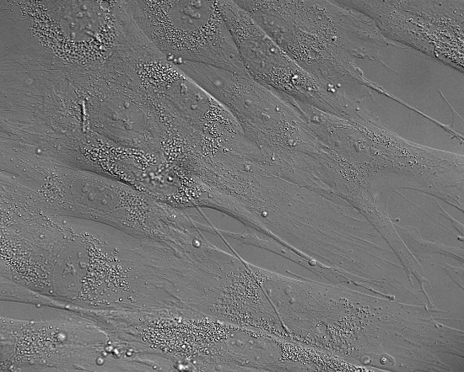
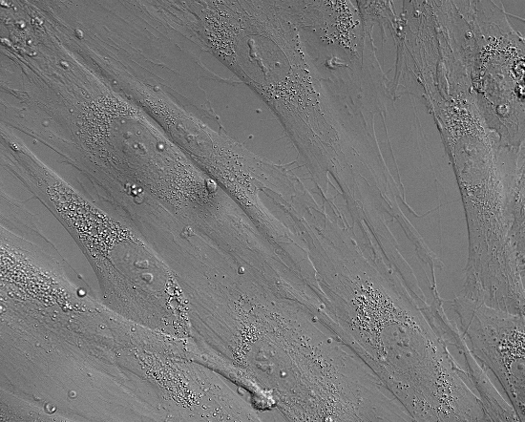
Images for the network
Can you discriminate between wt and ko cells?
Dirt in light path ☹ But same for wt and ko images
Examples (550x442 px):
wt
ko

Slide 5
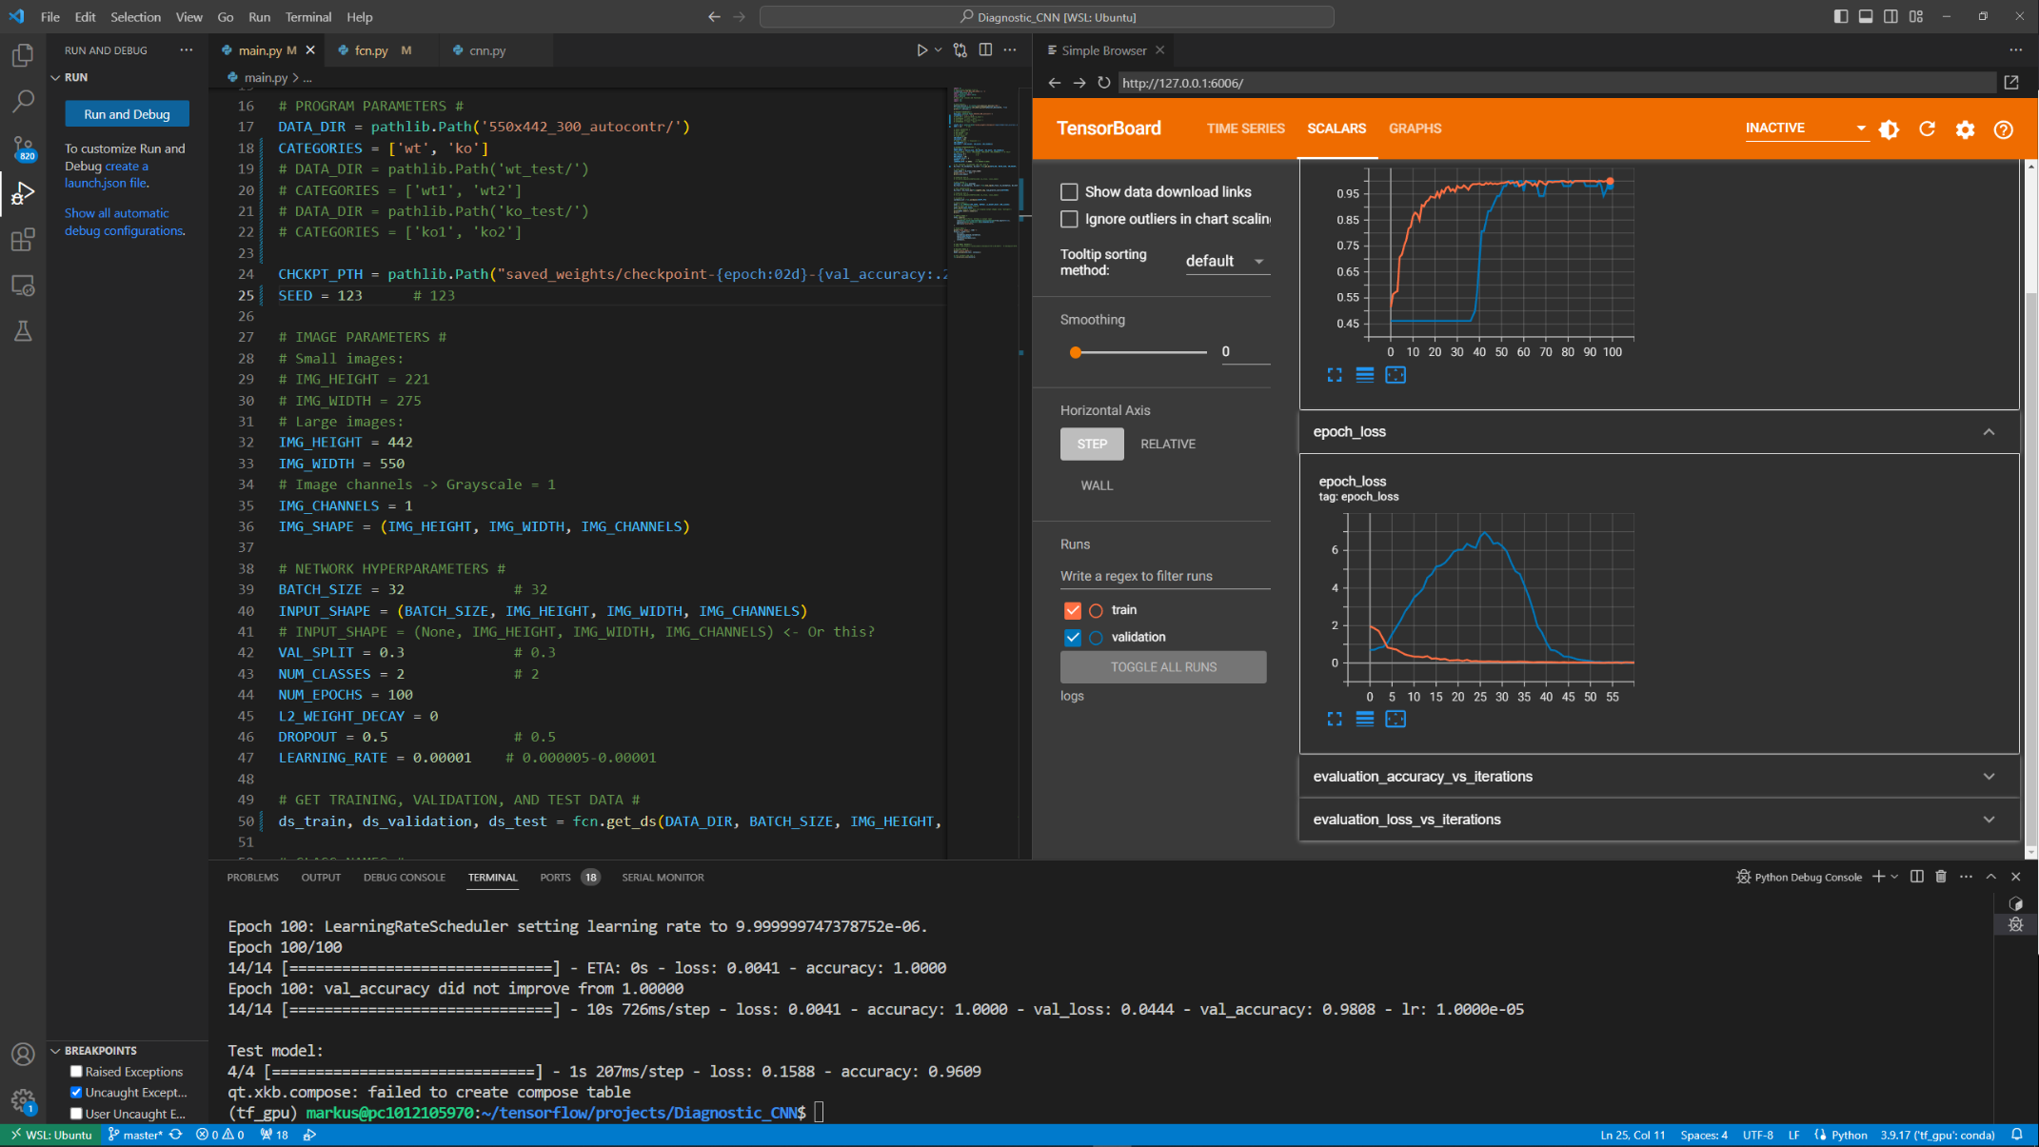
Software
Software: Visual Studio Code (Microsoft)
Written in python using tensorflow (and keras) library
Plotting of training progress with tensorboard

Slide 6
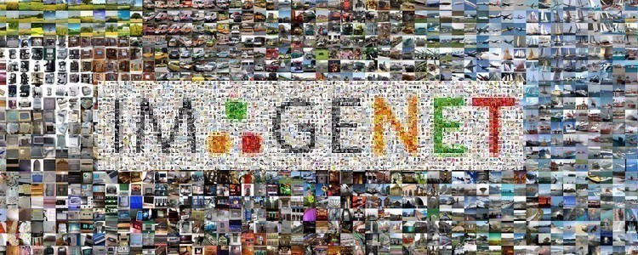
ImageNet and ILSVRC
VGG-16 like architecture
VGG: Visual Geometry Group from University of Oxford
16: 16 layers = deep learning network
First described: K. Simonyan, A. Zisserman; Very Deep Convolutional Networks for Large-Scale Image Recognition; International Conference on Learning Representations, 2015
Second place at the ILSVRC (ImageNet Large Scale Visual Recognition Competition) 2014 in the classification task
ImageNet: dataset of over 15 million images with 22,000 categories
ILSVRC uses subset of ImageNet with 1000 images in each of 1000 categories
Error rate: 8.8% (today: 3.5%, human error rate: 4%)

Slide 7
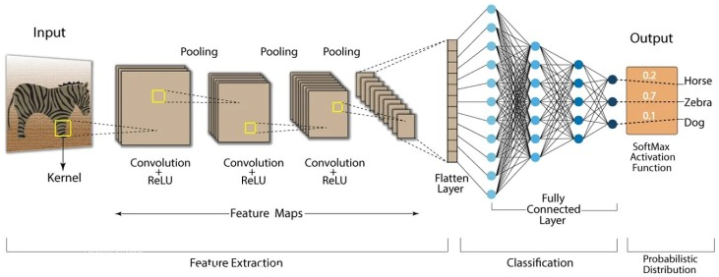
Convolutional neural networks (CNNs)
Special type of neural networks which are specialized on image recognition and image classification
Inspired by the visual cortex: Cortical neurons respond to a small region in the visual field called the receptive field
Receptive fields of different neurons partially overlap
Repetitive units of convolutional layers followed by a pooling layer
Convolutional layer: “filters” (= kernels) of 3x3 pixel are scanning the image and produce feature maps
Pooling layer: reduction of the image size
Feature maps (512) of last convolutional layer are “flattened”
Two or more fully connected layers for classification

Slide 8
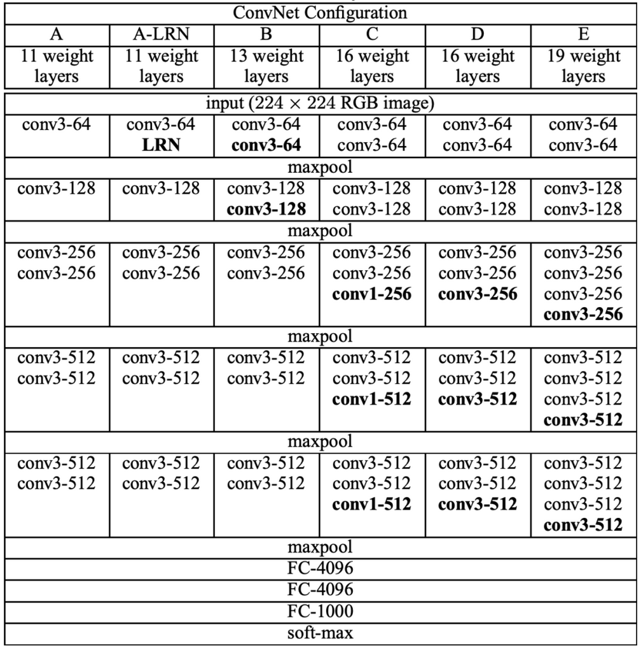
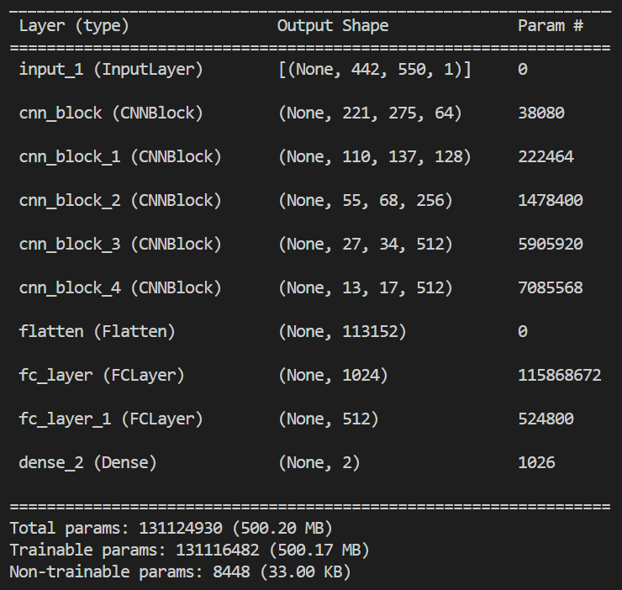
The CNN architecture
Different types of VGG networks (A-E): different amount of convolutional layers
Type D is used for the project
Less nodes in the fully connected layers
Last layer has two nodes, one for wt and one for ko
FC-1024
Architecture E too large for video RAM (Nvidia RTX 3090 with 24 GB VRAM)
FC-512
FC-2

Slide 9
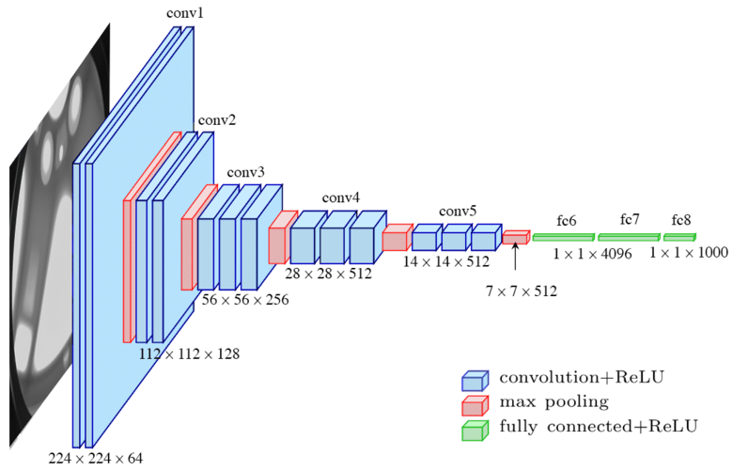
Data preparation and augmentation
Data preparation:
Data splitting (see below)
Batch size: 32
Shuffling of data
Normalization of gray values 0-255 to range 0-1
Data augmentation:
Flip images randomly left/right
Flip images randomly up/down
-> That the network does not train on growth direction of the cells

Slide 10
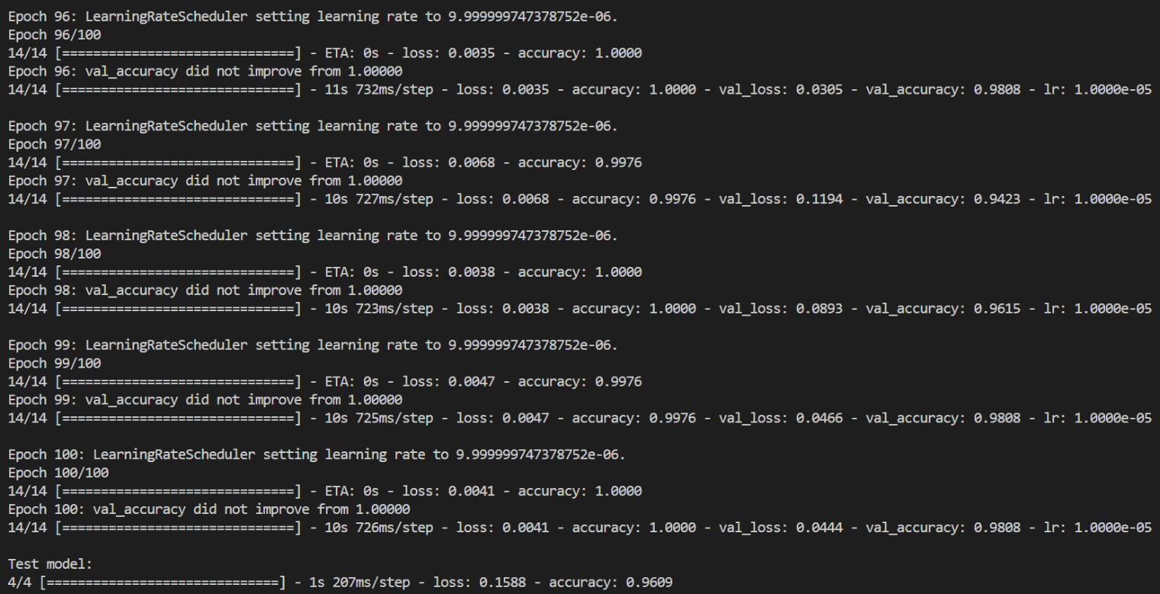
Some technical terms
Epoch: When all images are used once for training
Training normally requires several epochs (here 100)
(Mini)Batch: Not all images can be used at the same time during one epoch as they all have to fit into VRAM! Split images into batches (here 32)
Loss: Value which is minimized during training. The lower the better
Accuracy: Percentage of images, which the network classifies correctly. The higher the better
One epoch:
No 96 of 100
14 batches in one epoch
training
Last epoch of training (100)
Test model after training
96% of test images correctly classified

Slide 11
Data splitting
Split images in 3 groups:
Training images (70%)
Validation images (10%): monitor progress during training at the end of each epoch
Test images (20%): test model after training
Validation and test images are never ever used for training!
Loss and accuracy for training images
Loss and accuracy for training images
Test images
Loss and accuracy for test images

Slide 12
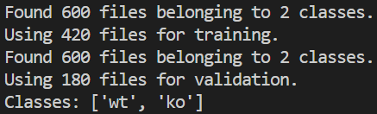
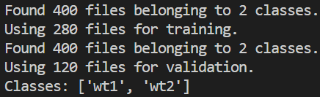
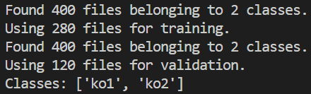
Preliminary testing
Results dependent on seed! (random data split)
For testing only one dish of one CLN7 patient and one dish of one healthy person were used so far. This is not enough and just for testing the network!!!
Pictures were excluded when: - dirt or dead cells were present - no or only a few cells were on the image
Pictures were excluded to get about the same cell density in both groups
Performed tests: - wt vs. ko (300 images each: 420 training, 60 validation, 120 testing) - same (wt) cells (2x400 images) - wt vs. wt (200 images each: 280 training, 40 validation, 80 testing) - ko vs. ko (200 images each : 280 training, 40 validation, 80 testing)
Every second picture was taken for separating wt1 vs. wt2 and ko1 vs. ko2 to avoid local differences in the cell density
wt vs ko:
wt vs wt:
ko vs ko:

Slide 13
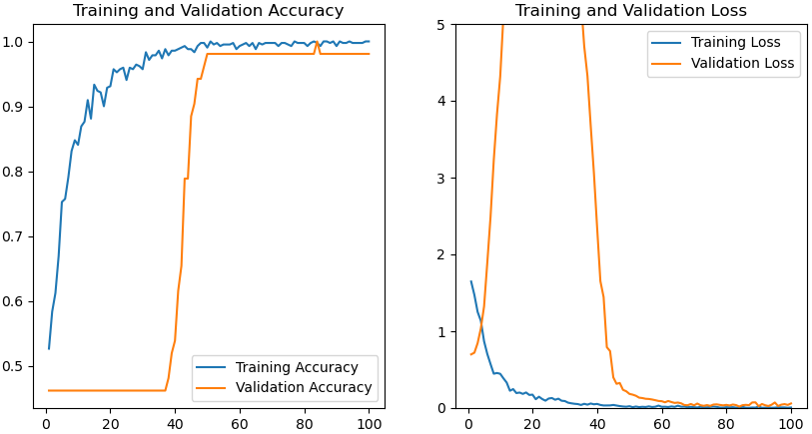
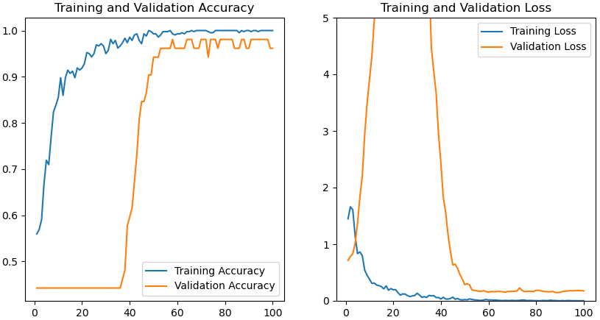
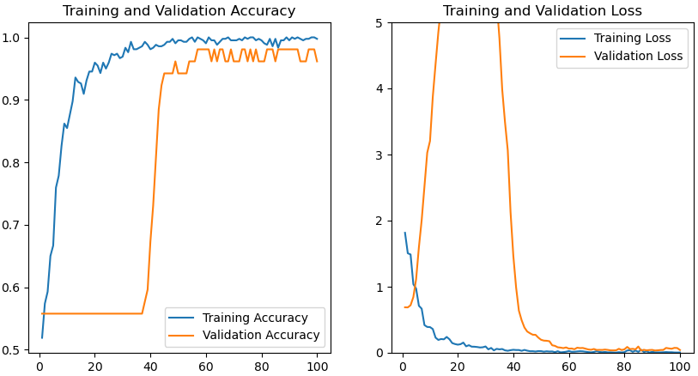
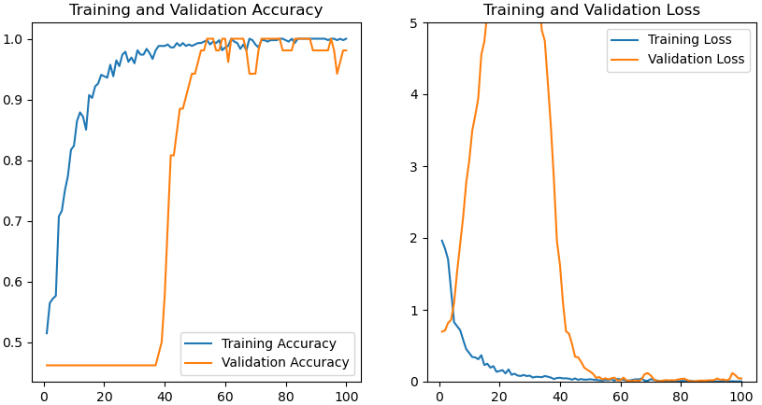
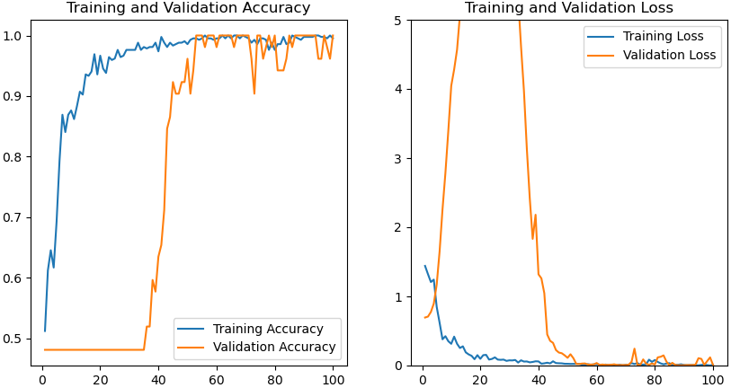
WT vs. KO
seed 222
acc: 96%
seed 444
acc: 97%
seed 333
acc: 96%
seed 123
acc: 100%
seed 111
acc: 97%
The network can discriminate the two groups with an accuracy of more than 95%!
At around epoch 35 the network learns the appropriate filters

Slide 14
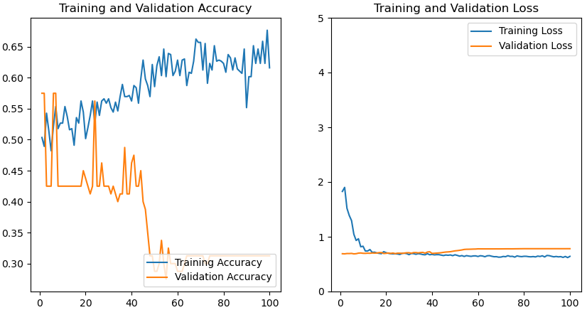
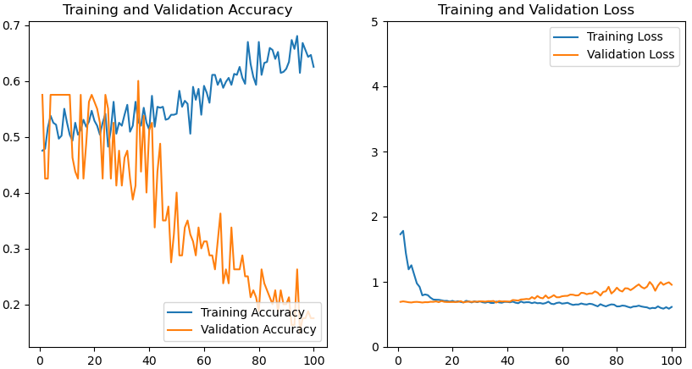
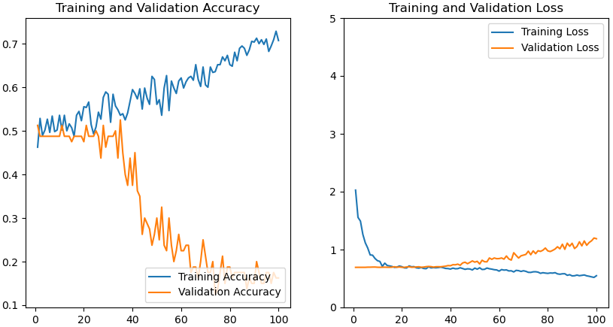
Exact same pictures in both groups
seed 298
acc: 26%
seed 123
acc: 13%
seed 111
acc: 18%
The network cannot discriminate between the two identical groups!
A validation accuracy of 50% or less means that you can also flip a coin

Slide 15
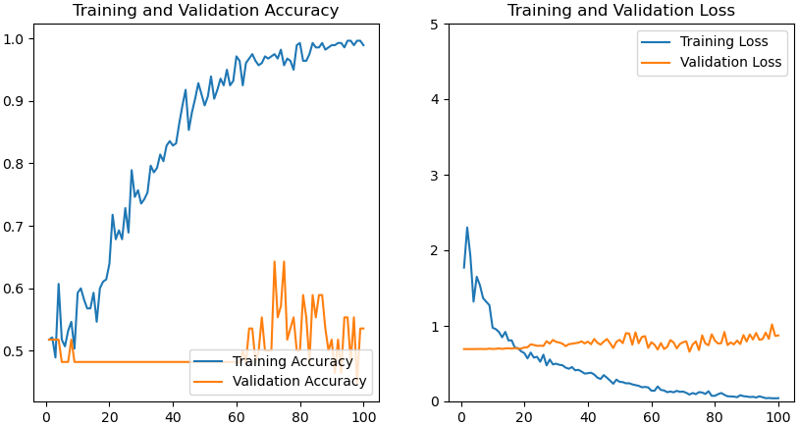
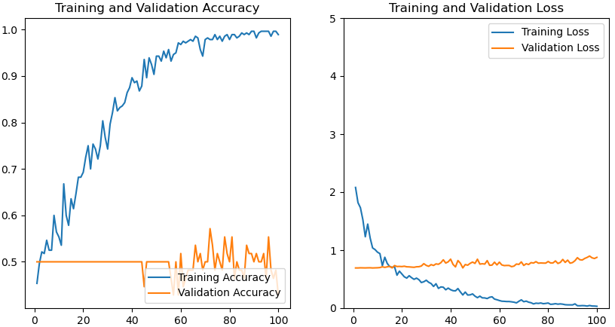
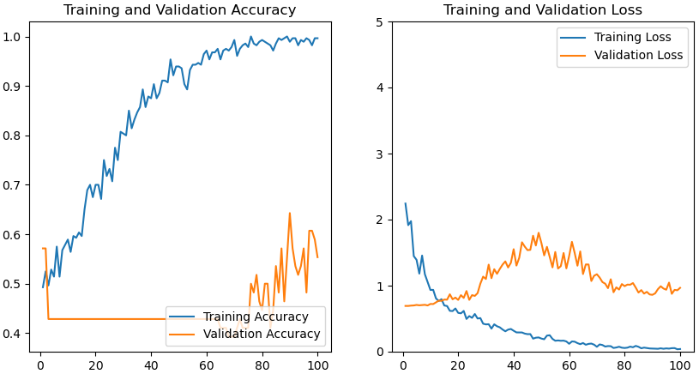
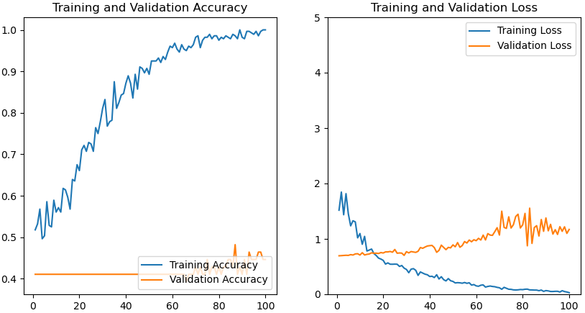
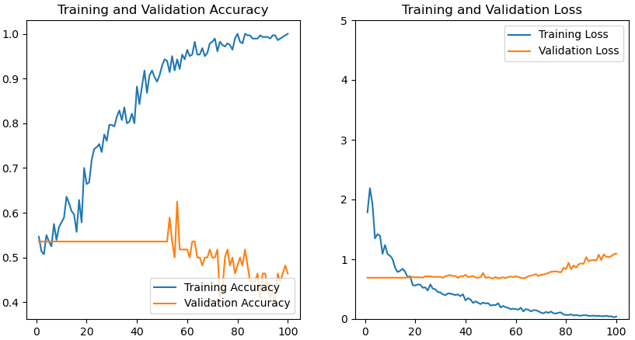
WT1 vs. WT2
seed 222
acc: 45%
seed 444
acc: 41%
seed 333
acc: 53%
seed 123
acc: 32%
seed 111
acc: 53%
The network cannot discriminate between the two wt groups!
If the wt group is split in half (and not every second image) it can discriminate…

Slide 16
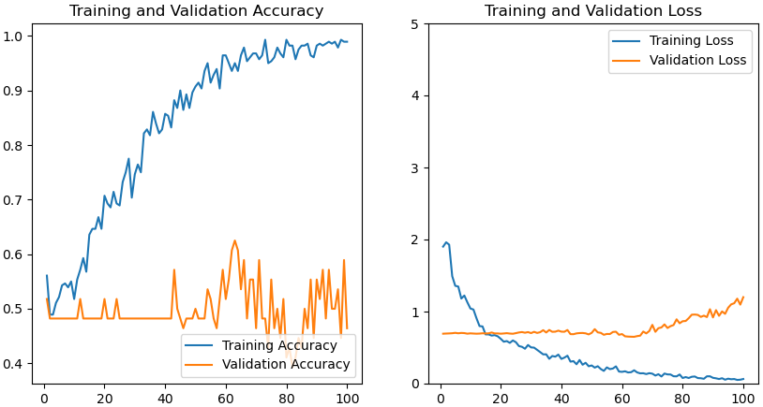
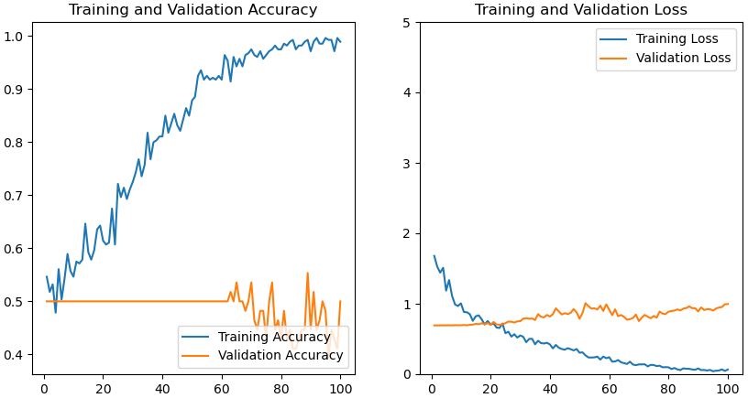
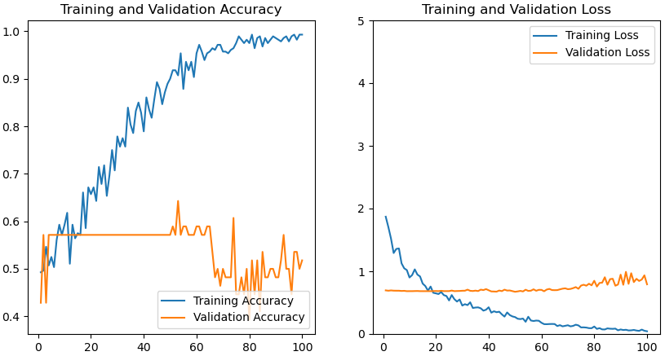
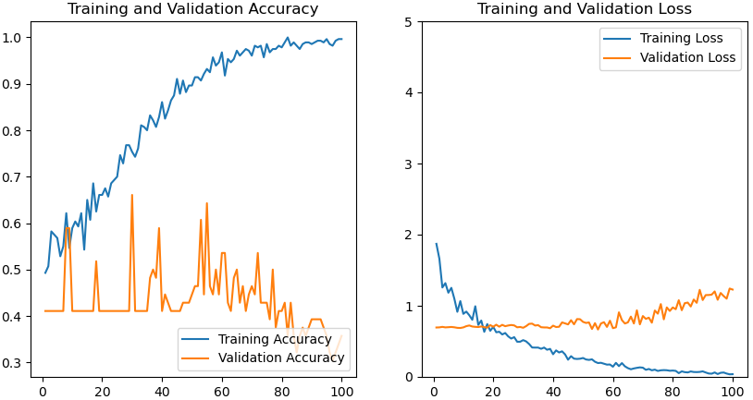
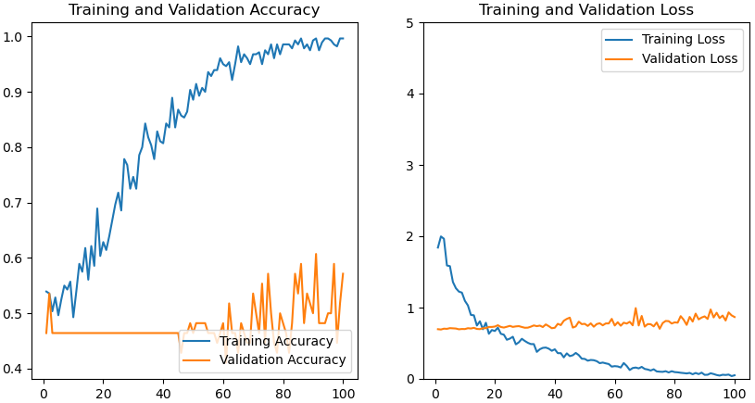
KO1 vs. KO2
seed 222
acc: 42%
seed 444
acc: 53%
seed 333
acc: 58%
seed 123
acc: 32%
seed 111
acc: 48%
The network also can’t discriminate between the two ko groups!

Slide 17
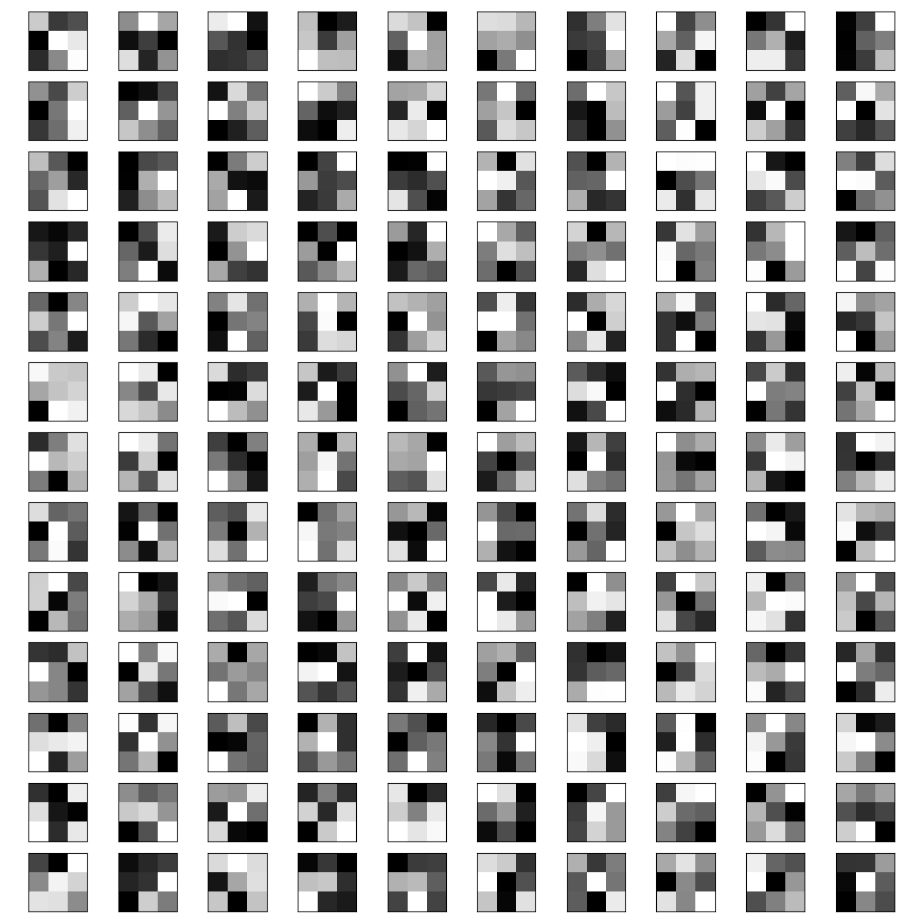
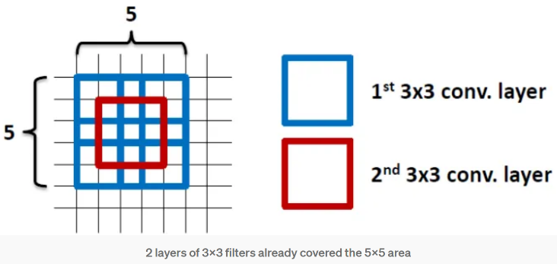
Visualizing filters
All filters have a size of 3x3 pixel
The values of the filters is what the network is actually adjusting during training
Based on the filters there is no chance to see on which structures the network is training on
Two subsequent cnn layers with a filter size 3x3 result in a filter of 5x5, but with less parameters

Slide 18
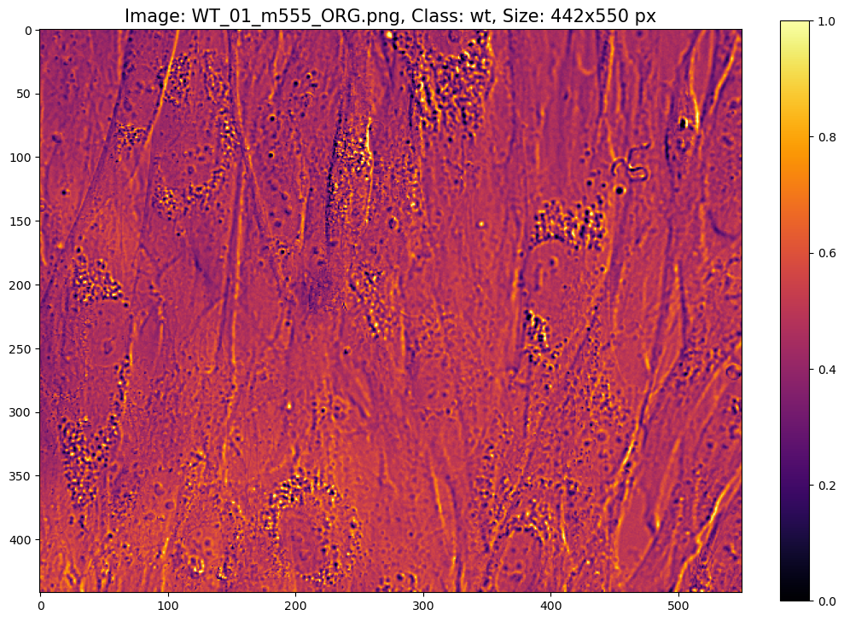
Visualizing feature maps

Slide 19
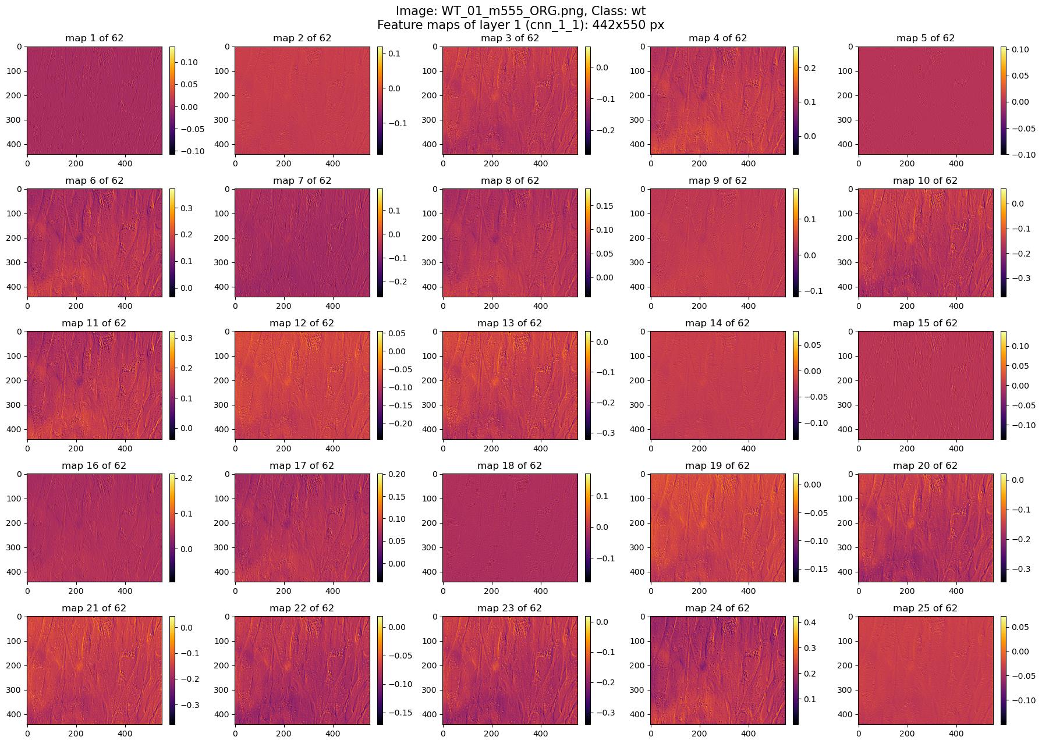

Slide 20
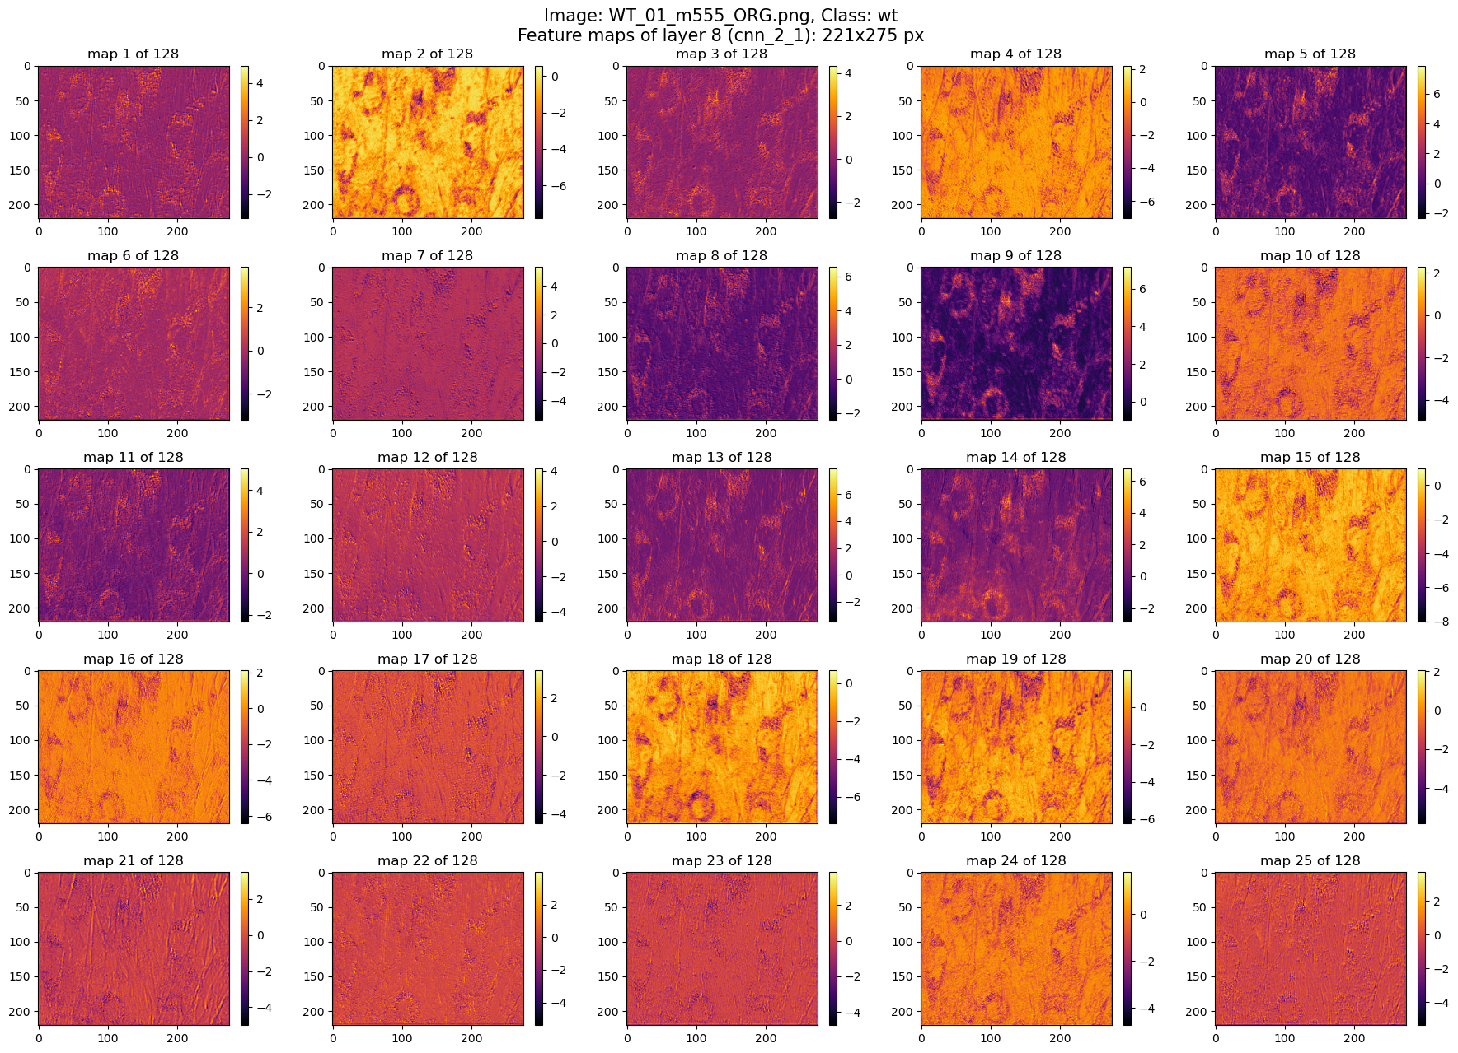

Slide 21
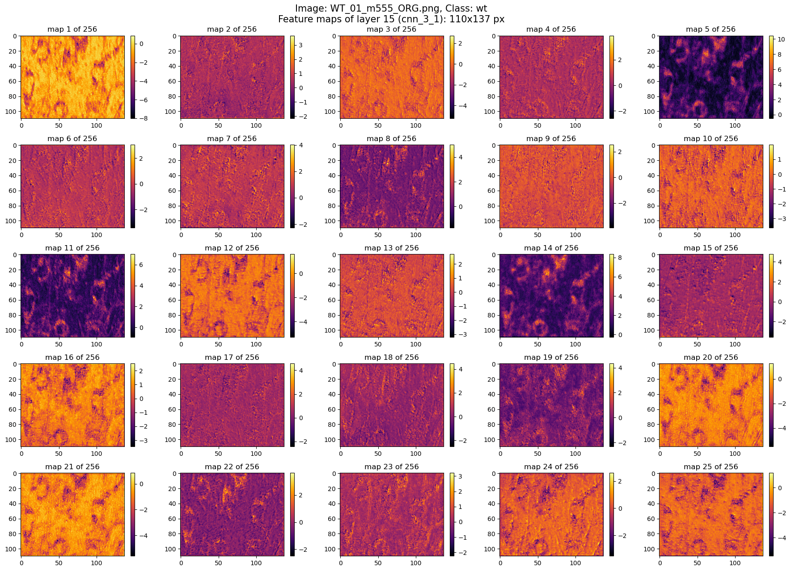

Slide 22
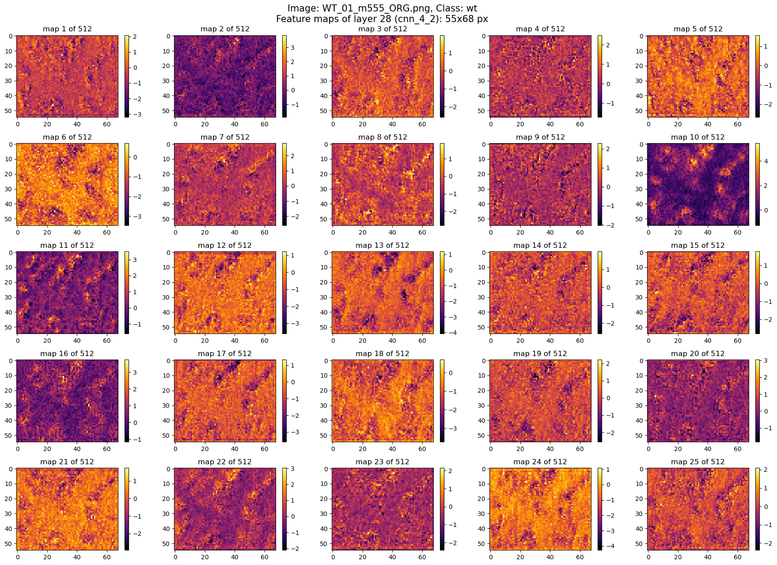

Slide 23
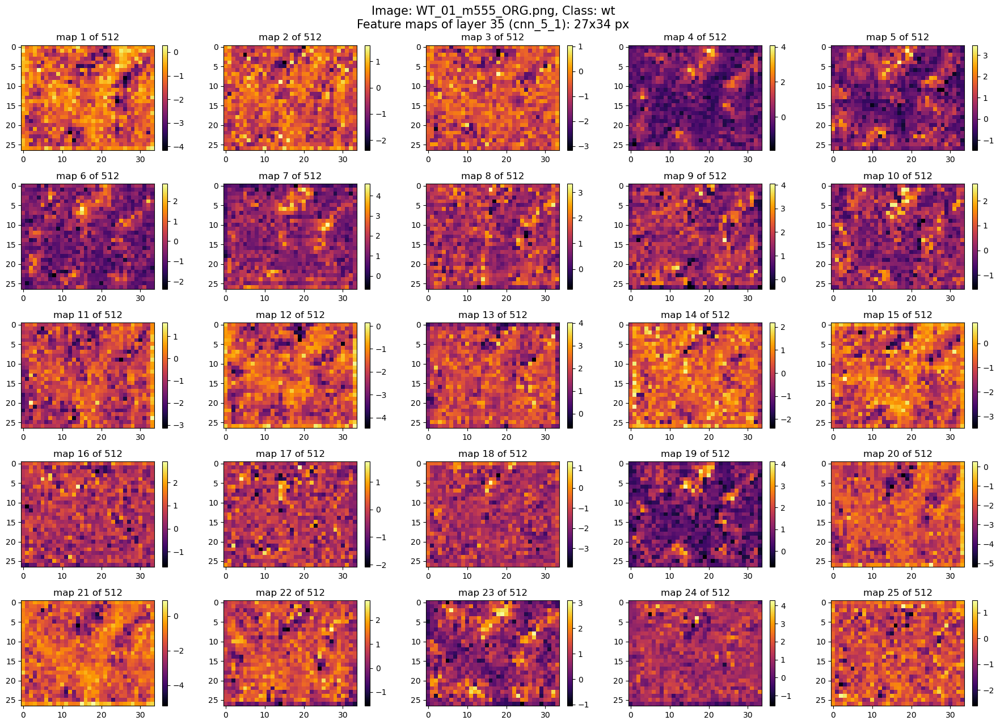

Slide 24
The end

Slide 25
Features and Regularization
Network features:
Activation function in all layers: ReLU
CNN layers: Kernel size: 3x3, stride: 1, padding: same
Pooling layers: 2x2 pooling, stride: 2, max pooling
Classifier: 2 nodes (wt and ko) with softmax activation function (no binary classification with binary cross entropy to add more groups later)
131,116,482 (500.17 MB) trainable parameters
Regularization:
Batch normalization after each CNN layer
Dropout of 50% in the first two fully connected layers
Optional L2 regularization possible, but currently not used

Slide 26
Training
Max 100 epochs
Early stopping (keras.callbacks.EarlyStopping): patience 20, monitor: validation accuracy
Learning rate scheduler (keras.callbacks.ReduceLROnPlateau): epoch 1-39: 1e-5, 40-59: 1e-6, 60-79: 1e-7, 80-100: 1e-8
Automatic saving of model weights with an validation accuracy > 98% (keras.callbacks.ModelCheckpoint)
Monitoring of test loss/accuracy and validation loss/accuracy with tensorboard during training (keras.callbacks.TensorBoard)
Evaluation/Test of the model using the test dataset after training (loss/accuracy)
epoch 96-100 (without
early stopping) and test of the model at the end of the training

